Slide 1
MADS
Manish Gangal
Aditya Doshatti
Devashish Nyati
Sojan Mathew

Slide 2


Slide 3
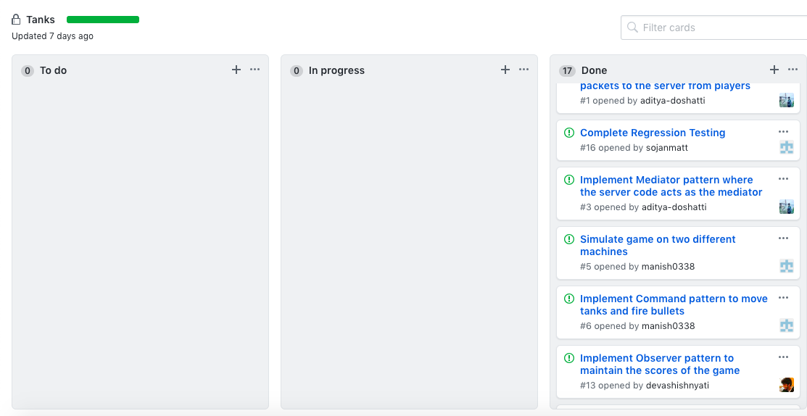
Scrum task board
Notes:
Sojan

Slide 4
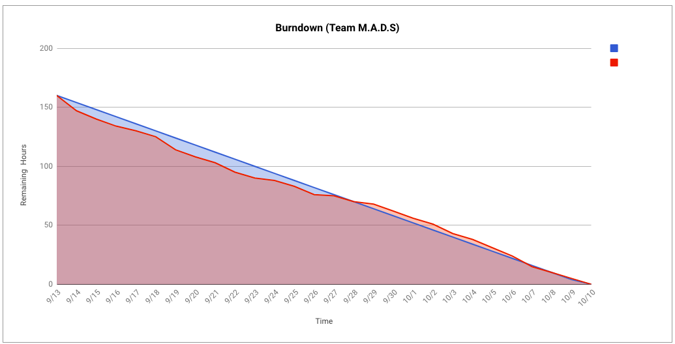
BurnDown chart
Notes:
Sojan

Slide 5
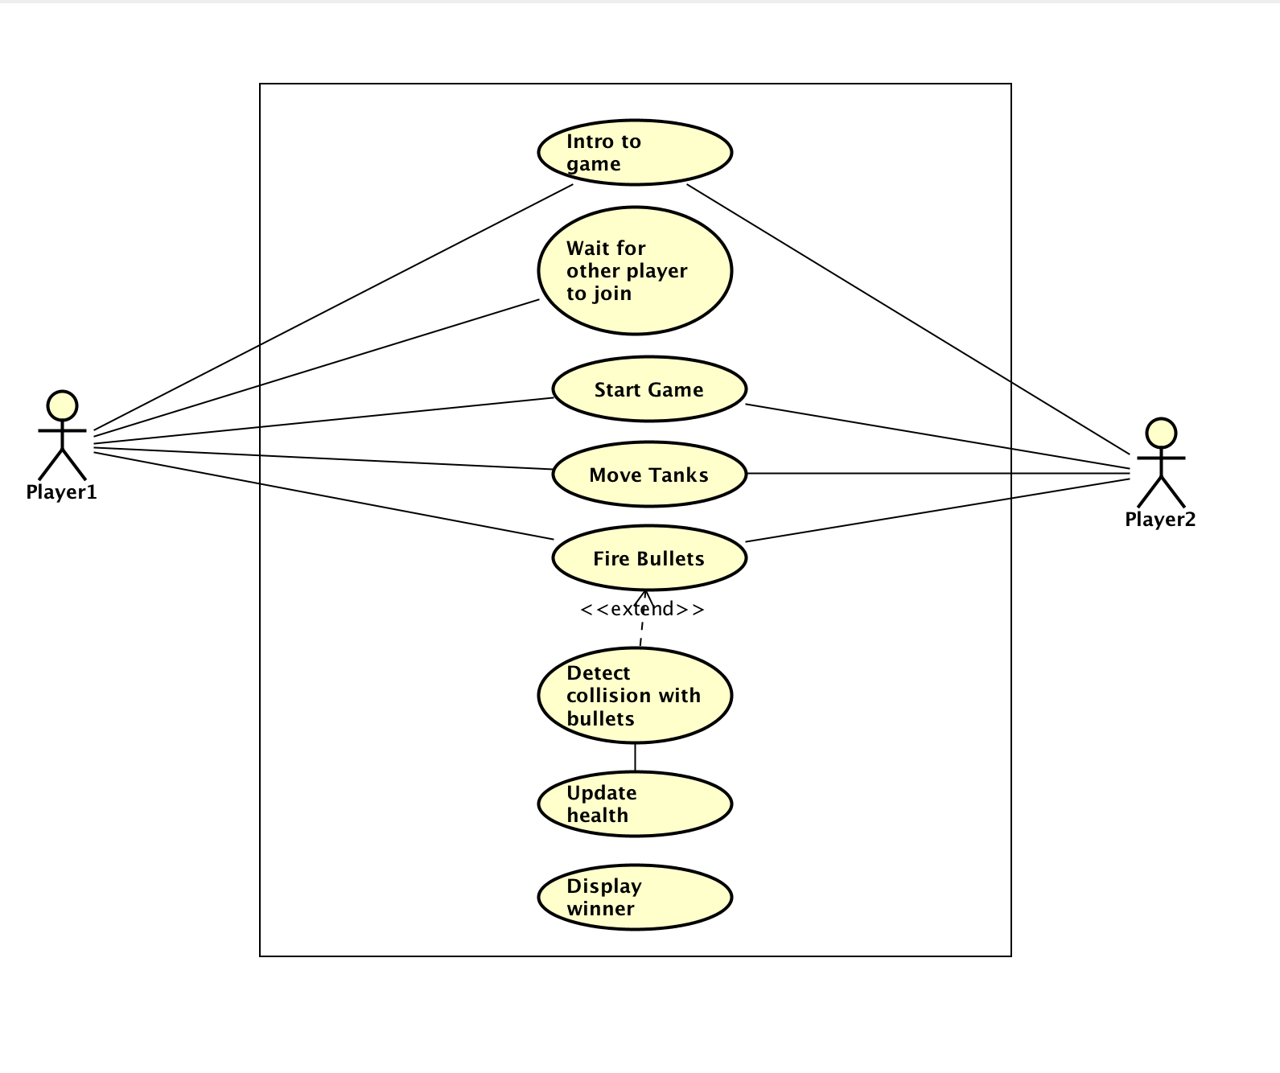
Use Case Overview
Notes:
Sojan

Slide 6
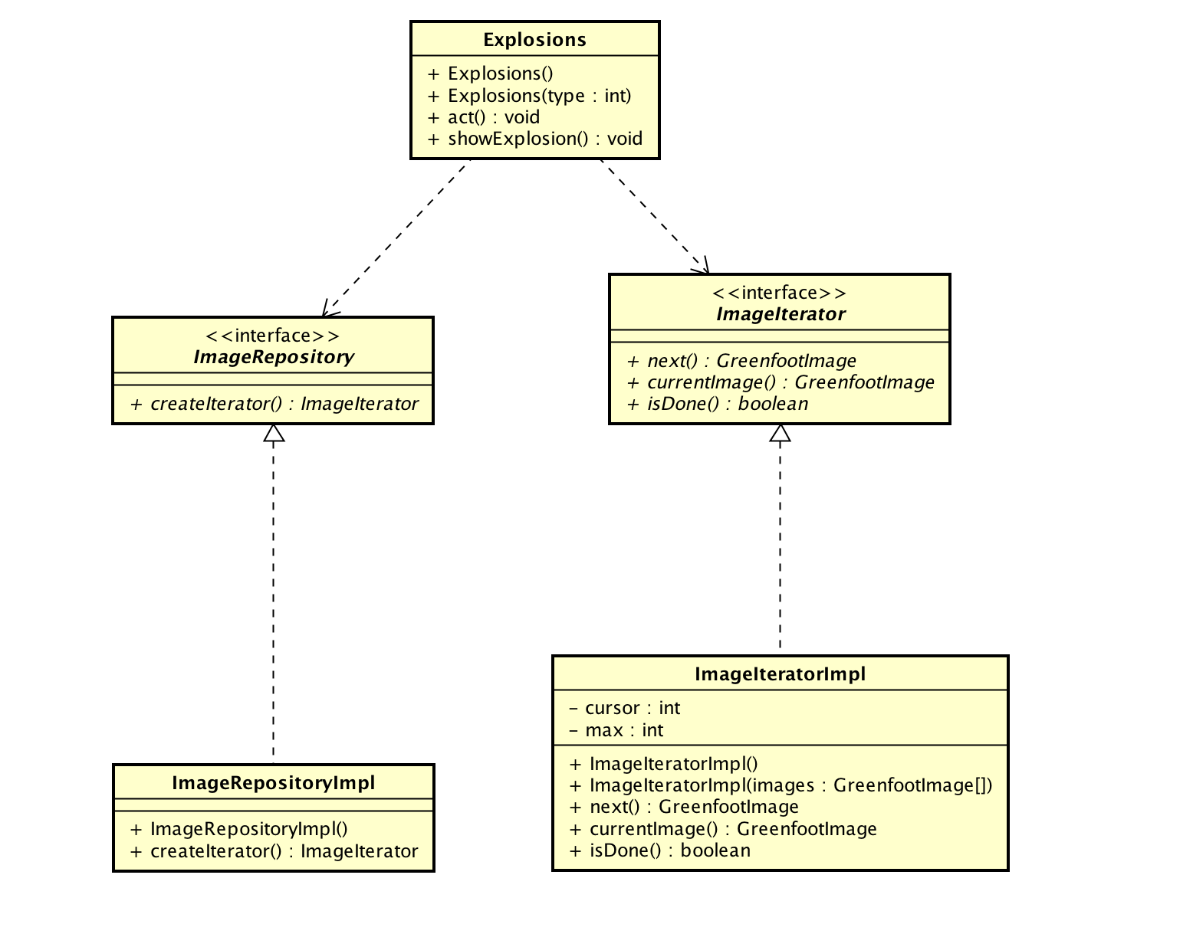
Iterator Pattern
Notes:
Sojan

Slide 7
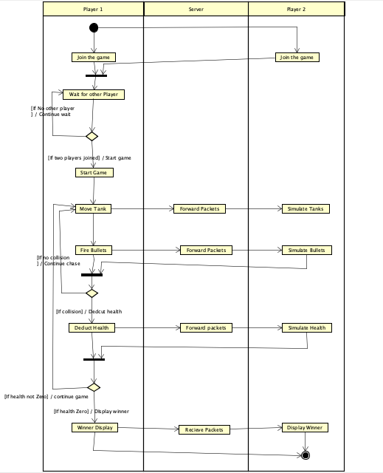
Activity Diagram
Notes:
Aditya

Slide 8
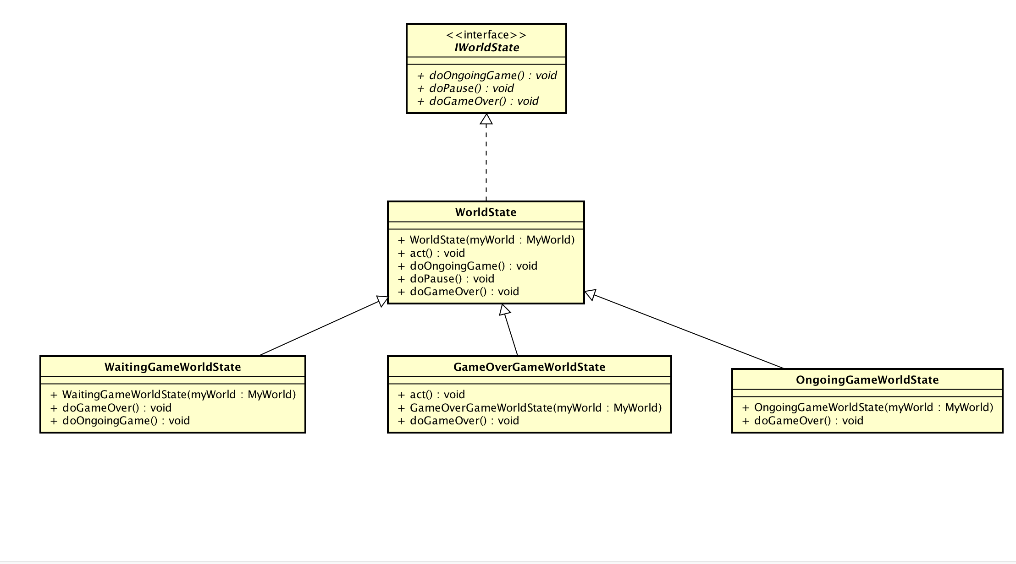
State Pattern
Notes:
Aditya

Slide 9
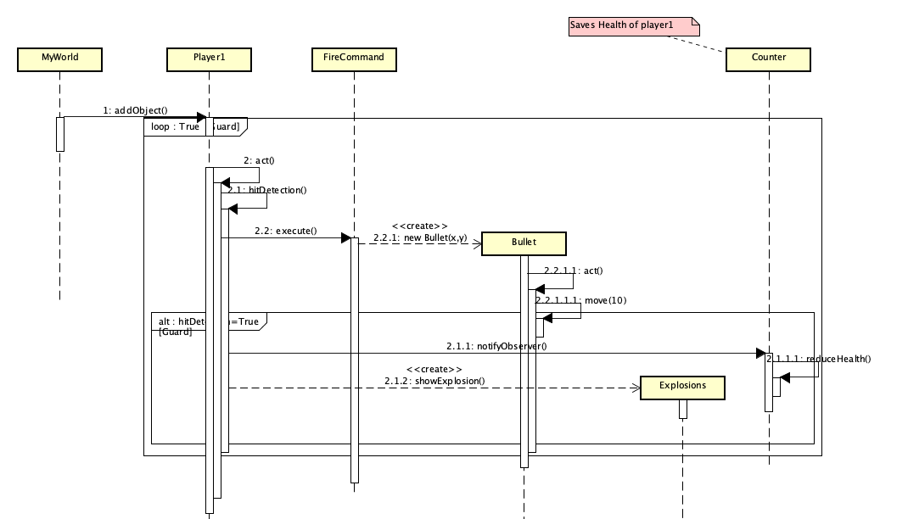
Sequence Diagram (Score Board)
Notes:
Devashish

Slide 10
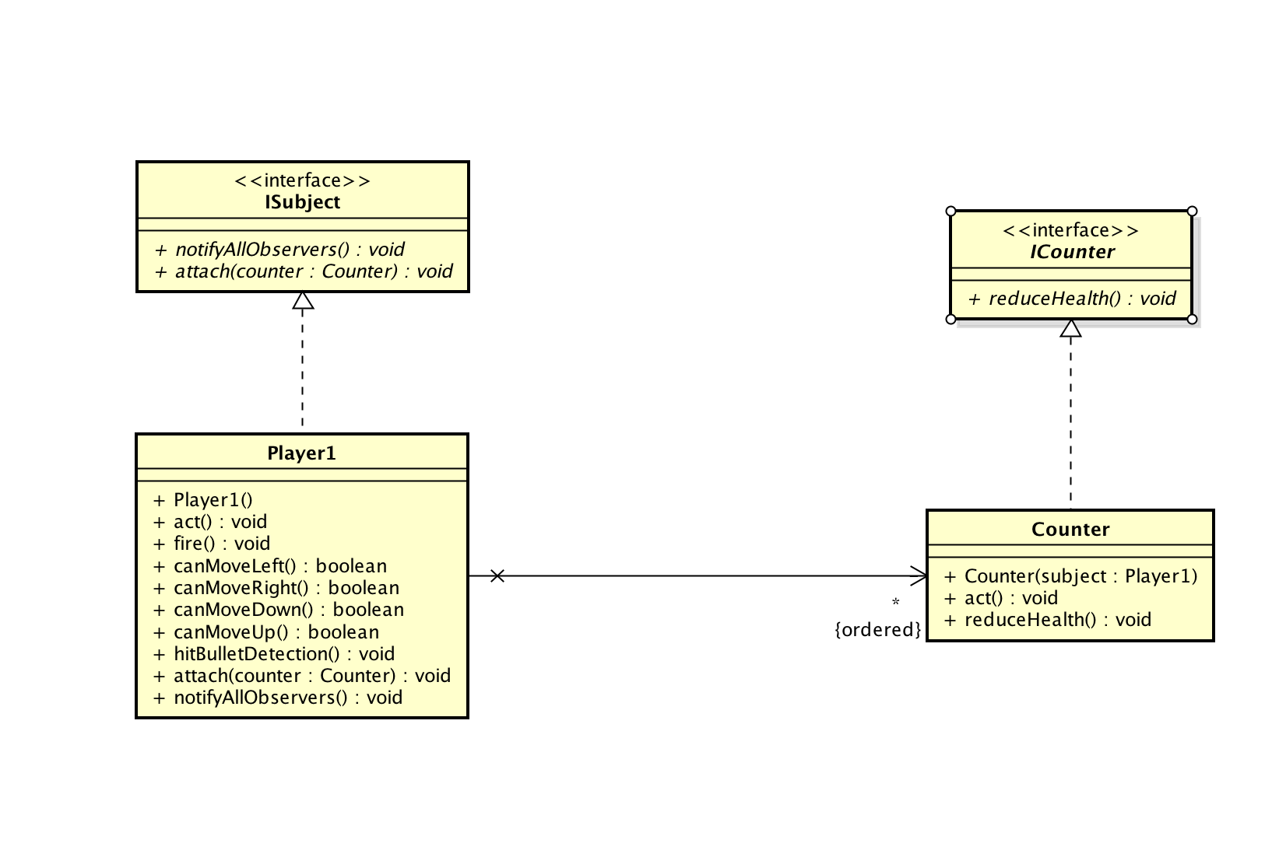
Observer Pattern
Notes:
Devashish

Slide 11
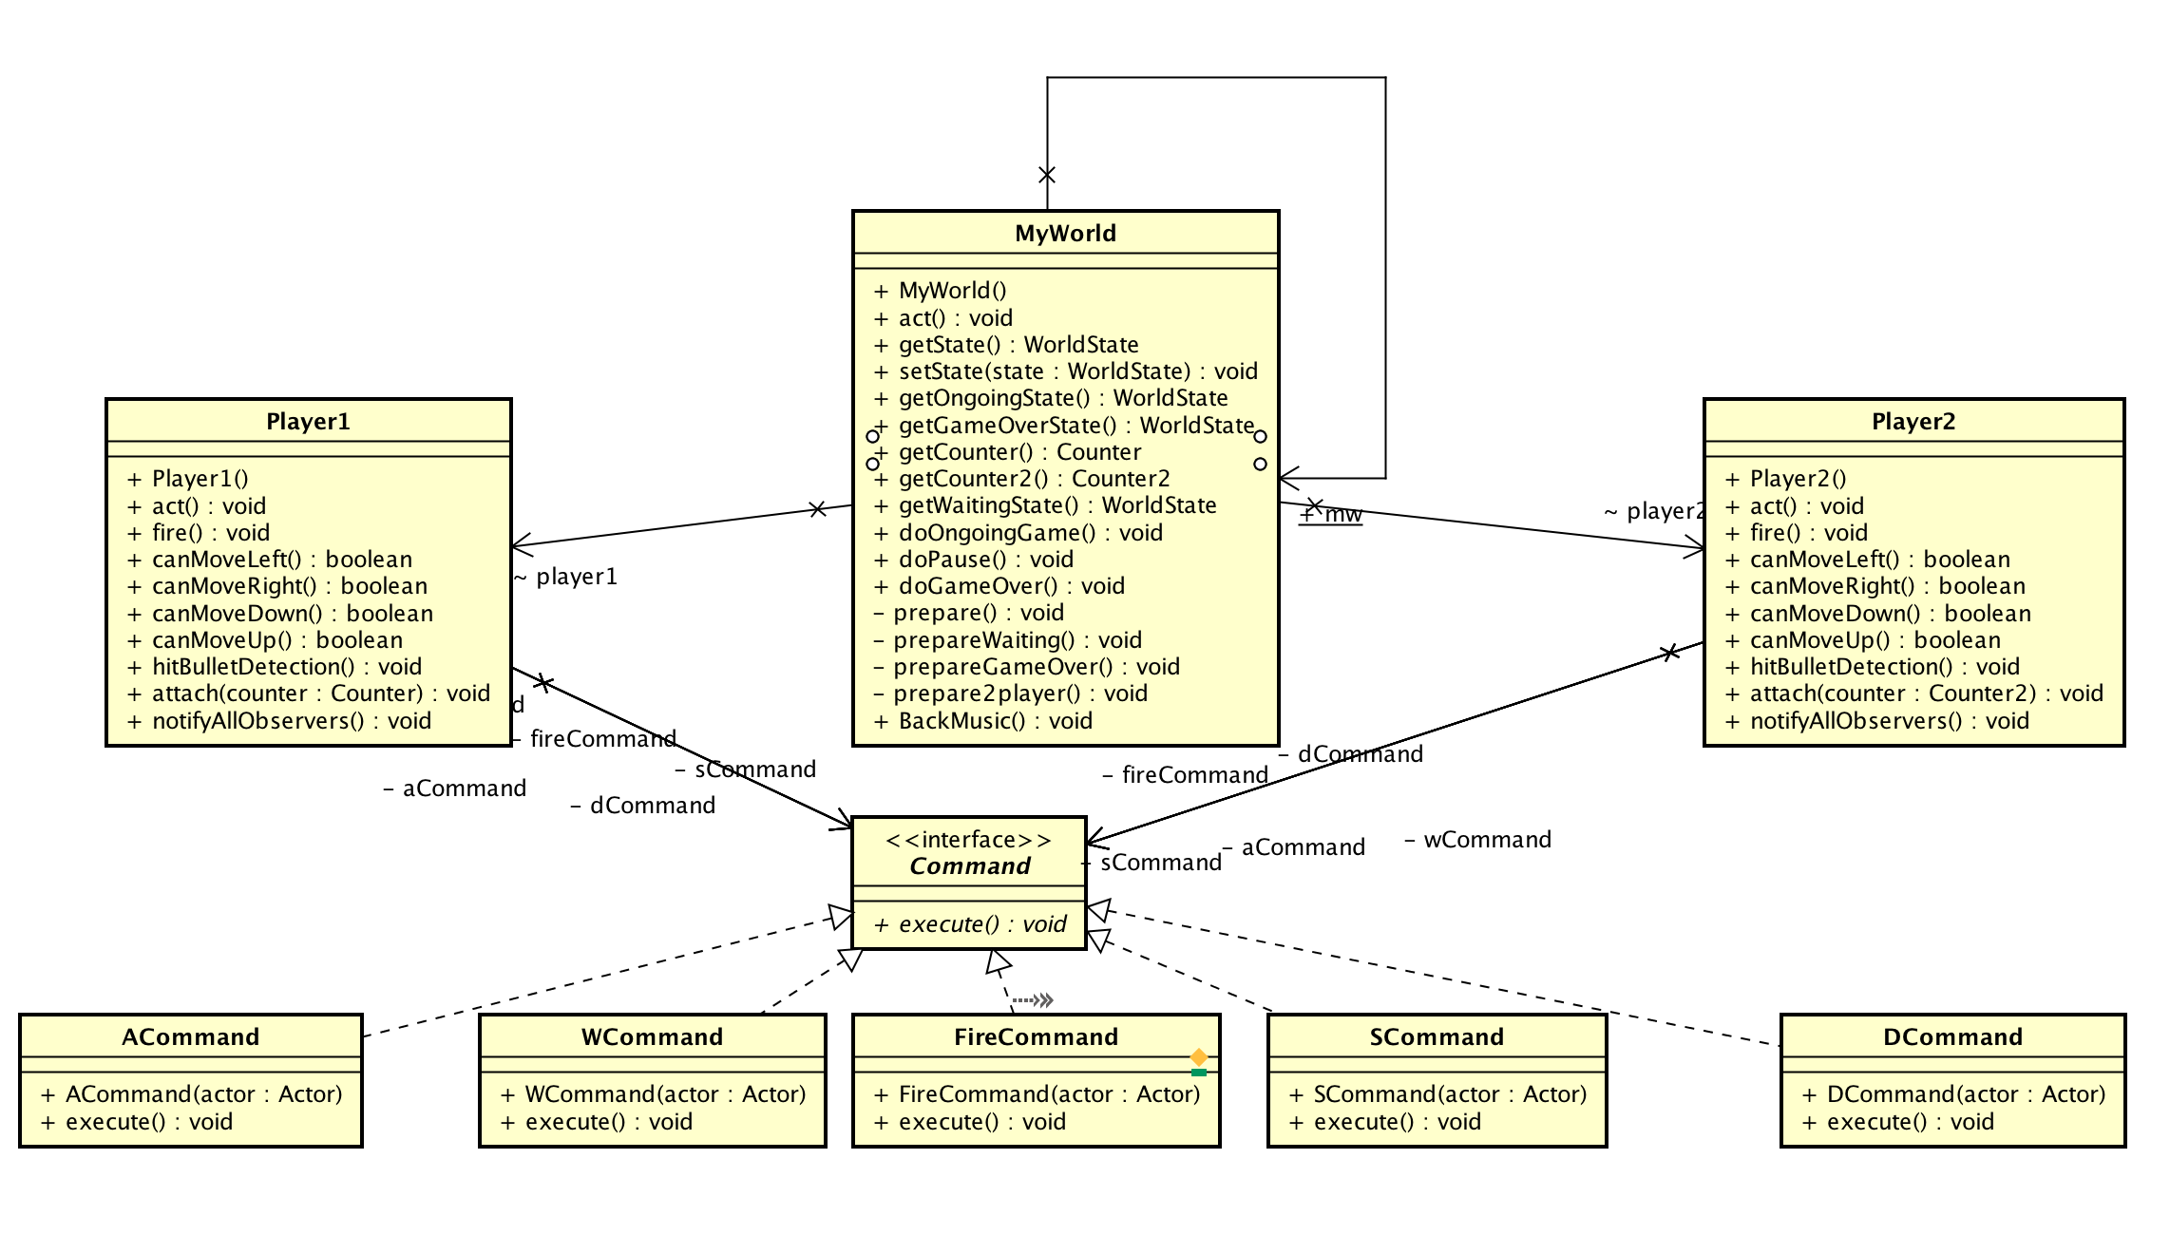
Command Pattern
Notes:
Manish

Slide 12
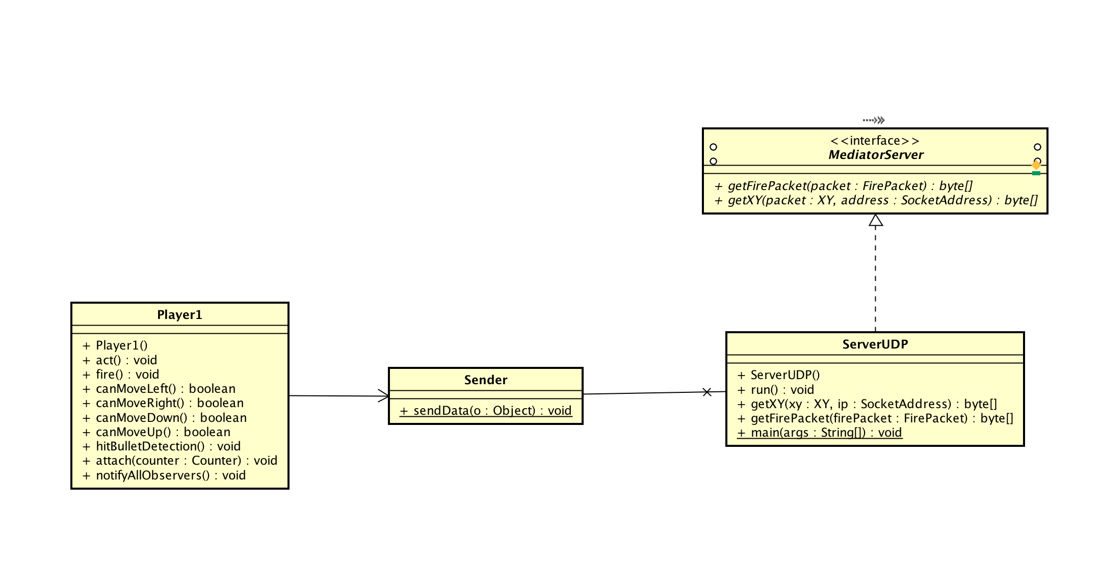
Mediator Pattern
Notes:
Devashish

Slide 13
Demo

